Slide 1
Fungi
By: Karla Vazquez, Briana Magana, Sara Murphy, Jade Chen, Imad Beazer, Alex Villanueva, and Crystal Varela

Slide 2
Index
Paracoccidioides brasiliensis (Blastomyces)
Penicillium marneffei
Blastomyces dermatitidis
Sporothrix schenckii
Aspergillus
Coccidioides immitis and Coccidioides posadasii
Histoplasma capsulatum (var. capsulatum and var. duboisii)
Mucorales
  Rhizopus
  Mucor
  Rhizomucor
  Lichtheimia (Absidia)
  Cunninghamella
Mycetoma

Slide 3
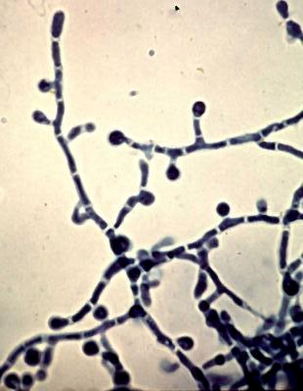
Paracoccidioides brasiliensis (Blastomyces)
· Prevalent to South and Central America, Brazil, Argentina, Colombia, and Venezuela
· Infection is usually subclinical, but can cause chronic and severe disease
· Thermally dimorphic, so it can exist in yeast form or as a mold
· Takes yeast form in human tissue or as a mold in nature
· Lungs are primary site of infection due to inhalation

Slide 4
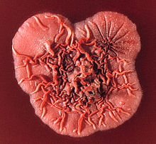
Penicillium marneffei
· It derives from Bamboo rats found in countries like China, Vietnam, Thailand, and Northern Eastern India. Main origin is South East Asia.
~ Is mainly found in the feces, lungs, liver, and spleen of these bamboo rats.
· Usually spreads the most during the rainy seasons when conditions are favorable for fungal spores to become airborne. During the rainy season is when the Bamboo rats breed.
· If exposed to the disease by inhaling the feces of the rats or by eating the rat, it is shown to cause a human infection called Penicilliosis. (Mode of Transmission)

Slide 5
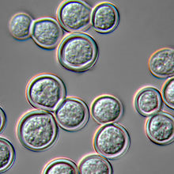
Blastomyces dermatitidis
· Primary agent for the Blastomycosis disease.
~ It’s an airborne disease that spreads and causes a pneumonia infection.
~ Typically thrives in wet soil and decaying wood. Usually found in an area close to a body of water such as a lake, river, or stream.
~ Anaerobe.
~ Indoor growth of the fungus can occur in debris damped accumulated areas.
· Found in North America in cities like Ontario, Quebec, and Manitoba.

Slide 6
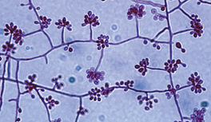
Sporothrix schenckii
Sporothrix schenckii is a fungus that primarily lives in soil and rose bushes.
It can be found in every environment all over the world
Reproduces in soil and rose bushes.
Infects individuals who encounter the spores from soil or rose bushes.
Causes a disease called Sporotrichosis, which can infect the skin or the tissue under the skin. This disease occurs when the Sporothrix schenckii spores enter an individual’s skin through a cut or scrape.

Slide 7
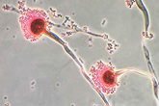
Aspergillus
Aspergillus is a mold that primarily lives in the air and soil.
It is indoors and outdoors, and it can be found in every environment all over the world.
Reproduces in the air and soil.
Because it is found everywhere, most individuals inhale the spores daily.
Infects individuals with weak immune systems. It does not harm individuals with strong immune systems.
Causes a disease called Aspergillosis, which can infect the lungs and sinuses. This disease occurs when an individual with a weak immune system inhales the Aspergillus spores.

Slide 8
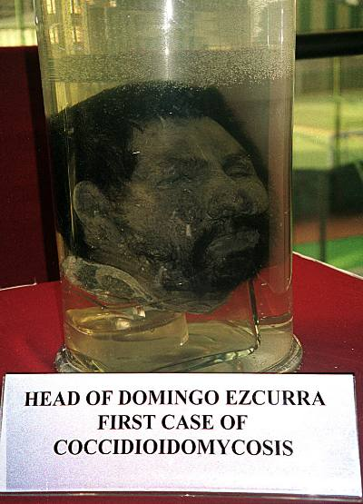
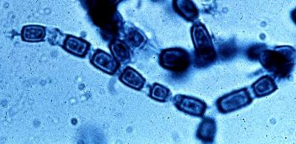
Coccidioides immitis and Coccidioides posadasii
Coccidioides immitis and posadasii are fungi that primarily reside in dry, highly alkaline soils.
Both Coccidioides immitis and posadasii cause the respiratory fungal infection, Coccidioidomycosis (Valley Fever).
Though Coccidioidomycosis is mild and can be resolved with no help, the infection can spread past the lungs and become severe.
Primarily found in the dry, arid, areas in the southwest of the United States and Northern regions of Mexico. Coccidioides immitis is only native to California.
C. posadasii can be distinguished from C. immitis by noting that C. posadasii is less halotolerant than C. immitis and the geographical location of where C. immitis is found as previously stated above.
During dust storms, Coccidioides are transmitted via arthroconidia (airborne fungal spores) and can be inhaled where spores can form into spherules.

Slide 9
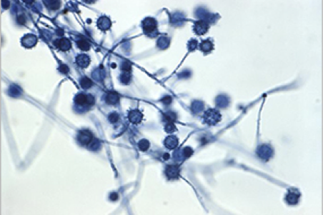
Histoplasma capsulatum (var. capsulatum and var. duboisii)
Can be found worldwide but is mainly common in North and Central America, particularly areas around the Ohio and Mississippi River Valleys.
Histoplasma grows best in soil that contains bird or bat droppings. Bats can get histoplasmosis and spread the fungus in their droppings.
Histoplasma spores circulate in the air after contaminated soil is disturbed. The spores are too small to see without a microscope. When people breathe in the spores, they are at risk for developing histoplasmosis. After the spores enter the lungs, the person’s body temperature allows the spores to transform into yeast. The yeast can then travel to lymph nodes and can spread to other parts of the body through the bloodstream causing Histoplasmosis.
Many people who get histoplasmosis will get better on their own without medication, but in some people, such as those who have weakened immune systems, the infection can become severe.
Most have no symptoms or have only a mild flu-like illness and recover without any treatment.

Slide 10
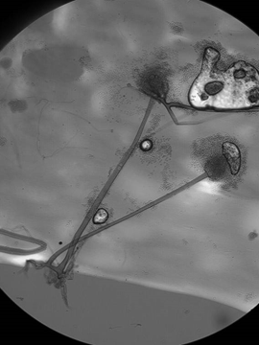
Mucorales Order: Rhizopus
Rhizopus arrhizus:
It is a decomposer, commonly found growing in soil, decaying fruits and vegetables, animal feces, and bread.
It is found worldwide.
It commonly causes rhinocerebral mucormycosis, but other organs can be involved such as the skin, subcutaneous tissue, and the lungs.
Most cases are associated with uncontrolled diabetes mellitus and haematological patients. It is a crazy, fast growing fungus and can cover a media plate in 24 hours.

Slide 11
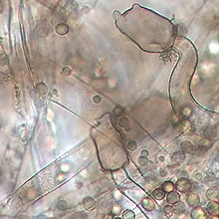
Mucorales Order: Mucor
Mucor plumbeus:
This fungi prefers to grow in alkaline soils and is commonly found contaminating indoor built environments or as the fermenting agent in cheese, apples, apple cider, and yogurt.
This fungus is found worldwide.
It is not known to be an animal or plant pathogen; however, it can activate the complement system through the alternative pathway.

Slide 12
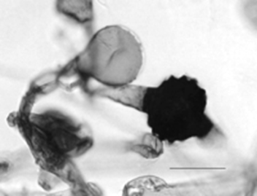
Mucorales Order: Rhizomucor
Rhizomucor pusillus:
For optimum growth: between 50-70°C. It is most commonly found in Compost piles and landfills.
It is found worldwide.
In humans it can lead to zygomycosis, necrosis of infected tissues and pen neural invasion.
When it is found, it is often in patients with weakened immune system, those with hematologyical malignancies, diabetes mellitus, and leukemia. In animals the fungus can be found in the kidneys and lead to mucormyotic abortion.
It is transmitted through inhalation of spores.

Slide 13
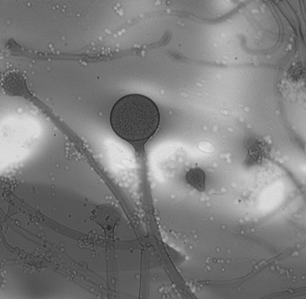
Mucorales Order: Lichtheimia (Absidia)
Lichtheimia corymbifera
It is most commonly found in soil and decaying plant debris and fermented foods.
It is found worldwide
In Humans it is associated with cutaneous, pulmonary, rhino-cerebral, central nervous system and disseminated infections. In animals it’s often associated with mycotic abortion.
It is less common for those with competent immune systems to catch, however, it is effortlessly easy to catch an infection when the immune system has been compromised due to reasons such as leukemia, surgery, etc.
The mode of transmission is through spore inhalation.

Slide 14
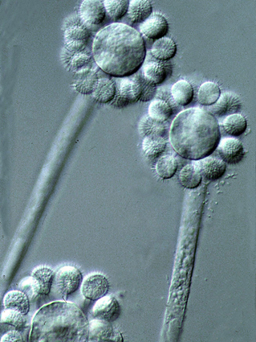
Mucorales Order: Cunninghamella
Cunninghamella echinulata:
It prefers soil enriched by nitrogen, phosphorus, and potassium.
It is found all over the world.
It is occasionally an agent of mucormycosis, skin infection or food poisoning.
It is not commonly reported in those with competent immune systems, but is found in those with compromised immune systems like those with HIV, diabetes, etc. It is commonly an air contaminant.

Slide 15
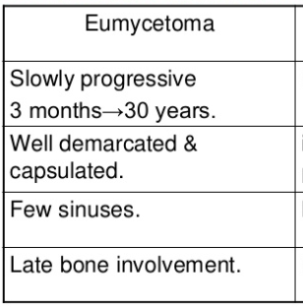
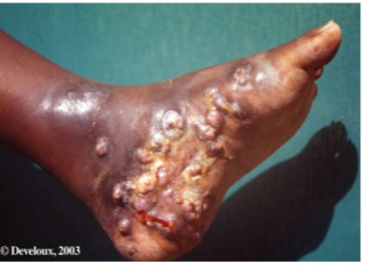
Mycetoma
Is a chronic infection of skin and subcutaneous tissue, named Madura foot, after the region of Madura in India where the disease was first identified.
This disease primarily affects poorer people in rural regions of Africa, Latin America, and Asia that are located near Earth’s equator and have dry climates.
Fungal mycetoma is usually found in Africa vs bacterial mycetoma is found in latin American countries
The resulting infection causes firm, usually painless but debilitating masses under the skin that can eventually affect the underlying bone
Mycetoma is a disease caused by certain types of bacteria and fungi found in soil and water.
Eumycetoma, the fungal form, caused by true fungi.
The causative organism is believed to enter the body through minor trauma usually entered through the foot.
Eumycetoma is usually treated with long-term antifungal medication, but treatment may not be completely effective. In this case, surgery or amputation are sometimes needed to cut away the infection tissue.

Slide 16
Works Cited
Iwen, P. C., Freifeld, A. G., Sigler, L., & Tarantolo, S. R. (2005). Molecular Identification of Rhizomucor pesillusas a Cause of Sinus-Orbital Zygomycosis in a Patient with Acute Mylogenous Leukumia. Journal of Clinical Microbiology, 11.
Jenny Bartholomew. (n.d.). Lichtheimia Corymbifera. Retrieved from Leading International Funal Education: http://www.life-worldwide.org/fungal-diseases/lichtheimia-corymbifera
Jenny Bartholomew. (n.d.). Rhizopus Arrhizus. Retrieved from Leading International Fungal Education: http://www.life-worldwide.org/fungal-diseases/rhizopus-arrhizus
Rhizopus. (n.d.). Retrieved from Go Pets America: http://www.gopetsamerica.com/bio/fungi/rhizopus.aspx
Rodrigo Camara-Lemarroy, C., Gonzalez-Moreno, E. I., Rodriguez-Gutierrez, R., Rendon-Ramirez, E. J., Ayala-Cortes, A. S., Fraga-Hernandez, M. L., . . . Galarza-Delgado, D. A. (2014). Clincal Features and Outcome of Mucormycosis. NCBI.
Webster, J. (1980). Introduction to Fungi. Cambridge University Press, 230.
Nongnuch Vanittanakom - Chester R.Cooper - Matthew C.Fisher - Thira Sirisanthana
https://www.ncbi.nlm.nih.gov/pmc/articles/PMC1360277/

Slide 17
Works Cited (continued)
Practice Essentials, Background, Pathophysiology
https://emedicine.medscape.com/article/224628-overview
Blastomyces dermatitidis, cause of blastomycosis, Tom Volk's Fungus of the Month for January2001
http://botit.botany.wisc.edu/toms_fungi/jan2001.html
“Sporotrichosis.” Centers for Disease Control and Prevention. 2016.
https://www.cdc.gov/fungal/diseases/sporotrichosis/index.html
“Sporothrix schenckii complex.” The University of Adelaide. 2015.
https://mycology.adelaide.edu.au/descriptions/hyphomycetes/sporothrix/
“Definition of Aspergillosis.” Centers for Disease Control and Prevention. 2015.
https://www.cdc.gov/fungal/diseases/aspergillosis/definition.html
“Sources of Aspergillosis.” Centers for Disease Control and Prevention. 2015.
https://www.cdc.gov/fungal/diseases/aspergillosis/causes.html
Welsh, Oliverio, et al. “Coccidioidomycosis.” Clinics in Dermatology, vol. 30, no. 6, 2012, pp. 573–591., doi: 10.1016/j.clindermatol.2012.01.003.
"Valley Fever (An Introduction)." Valley Fever: An Introduction, 2014. Health Reference Center Academic, uiwtx.idm.oclc.org/login?url=http://go.galegroup.com/ps/i.do?p=HRCA&sw=w&u=txshracd2623&v=2.1&it=r&id=GALE%7CCT2606970853&asid=de3062f27f1cd2f23512b0cbb16a08f2. Accessed 2 Nov. 2017.

Slide 18
Works Cited (continued)
Hospenthal, Duane R, et al. “Coccidioidomycosis and Valley Fever.” Background, Pathophysiology, Etiology, 19 Sept. 2017, emedicine.medscape.com/article/215978-overview#a3.
Pruthi, Sandhya. “Valley Fever: A Lung Infection of Desert Regions.” Mayo Clinic, Mayo Foundation for Medical Education and Research, 27 May 2015, www.mayoclinic.org/diseases-conditions/valley-fever/basics/risk-factors/con-20027390.

